Slide 1


Slide 2

Python for Data Science

Slide 3

So what type of activities are involved in DS?
Data cleaning/munging
- Pandas
Data exploration (summary statistics etc.)
- Pandas, Numpy
Data Visualization
- Pandas, Numpy, Matplotlib, Bokeh
Data Modelling
- Statsmodel, Sklearn, Keras , Sklearn-Image
Mathematical programming (calc. apart from modelling)
- SciPy,Numpy, Math, TensorFlow
Miscellaneous tasks (creating new variables etc.)
- Sklearn

Slide 4
Why different libraries, what does each do?
Pandas : Data manipulation and analysis tool. Offers data structures and operations for manipulating numerical tables and time series.
NumPy: support for large, multi-dimensional arrays and matrices, along with a large library of high-level mathematical functions to operate on these arrays. Similar to MATLAB.
SciPy: Collection of mathematical algorithms and convenience functions built on the Numpy extension of Python.
Sklearn: Python module for machine learning built on top of SciPy
Matplotlib: plotting library which produces quality figures

Slide 5
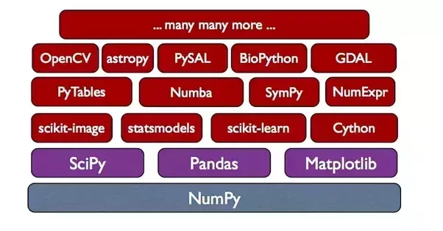
Relationship b/w libraries

Slide 6
Anaconda Docker
you can use the Anaconda Docker which has all packages pre-installed: https://anaconda.org/anaconda/python

Slide 7


